Slide 1

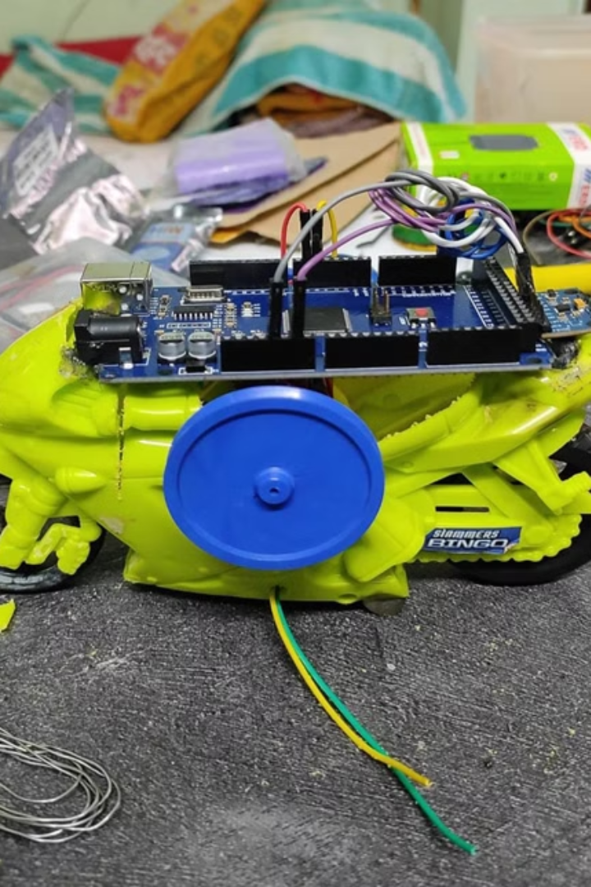
Self Balancing Bike Prototype

Slide 2
Introduction:
This project introduces a self-balancing bike, a technological leap forward in bicycle design. Unlike traditional bikes, this one utilizes sensors and algorithms to constantly maintain balance, making it perfect for new riders or anyone seeking a safer cycling experience. This innovative feature not only reduces the risk of accidents but also opens up cycling to a wider range of people. The project utilizes an Arduino Mega controller and an MPU9250 sensor to achieve this remarkable feat of balance.

Slide 3
Problem Statement:
Nowadays, the general accident data for the world shows that the maximum road accidents occurring are of the two wheelers. And, Needless of the lot of investment is being done into the manufacturing and Research and development of high quality and technology driven motor bikes none have been seen to guarantee road safety to the motor rider and the Pillion rider. The safety here solely depends on the rider’s skills and driving techniques. Also, road accidents are bound to occur as the person riding the bike loses control over it and the bike falls below its actual and theoretical point of fall. So here the necessity arises for a system that could act as a balancing aid to the bicycle rider.

Slide 4
Aim:
Contribute to the development of self-balancing technology for bicycles and explore its potential applications for improved accessibility and user engagement.

Slide 5
Objectives:
Design and construct a functional small-scale self-balancing bike prototype. This should be achievable within the timeframe of your internship and demonstrate the feasibility of the concept.
2. Utilize gyroscopic stabilization as the primary mechanism for maintaining balance. This sets the technical direction and distinguishes your project from other balancing methods.

Slide 6
Literature Survey:
No.
Title of Paper
Summary
1.
"Stabilization of a Two-Wheeled Self-Balancing Mobile Robot Using PID Control" (IEEE Transactions on Industrial Electronics, 2004)
This paper presents a classic PID control approach for self-balancing bicycles, analyzing its effectiveness and limitations in handling disturbances.
2.
"Adaptive Fuzzy Control of a Self-Balancing Two-Wheeled Mobile Robot" (IEEE Transactions on Fuzzy Systems, 2006)
This study explores the use of fuzzy logic control for adapting to varying operating conditions and achieving robust balance.
3.
"Model-Based Predictive Control for Balancing a Self-Balancing Electric Scooter" (IEEE Transactions on Industrial Electronics, 2017)
This paper implements a model-predictive control (MPC) approach to achieve superior tracking performance and disturbance rejection.
4.
"Multi-Sensor Based Localization and Mapping for an Indoor Self-Balancing Scooter" (IEEE Robotics and Automation Letters, 2020)
This paper describes a multi-sensor fusion approach for precise localization and mapping within indoor environments, enabling autonomous navigation for self-balancing vehicles.

Slide 7
Motivation:
We're developing a self-balancing bike to open the joy of cycling to everyone. This project is motivated by a desire to make cycling safer, easier, and more accessible. By automating balance, we can empower people of all abilities to experience the freedom and fun of two-wheeled exploration.

Slide 8
Scope:
Enhanced Safety Features
Environmental Adaptability
Personalization Options
Integrated Health and Fitness Tracking
Integrate collision detection systems and emergency braking mechanisms to further improve rider safety on the self-balancing bike.
Develop adaptive suspension systems that can adjust to different terrains and weather conditions, ensuring optimal performance across various environments.
Provide customization features such as adjustable seat height, handlebar position, and riding modes to accommodate individual preferences and comfort levels.
Implement sensors to monitor rider health metrics, track fitness goals, and provide personalized workout recommendations.

Slide 9





Methodology Details:
Sensor Data Acquisition
The Arduino Mega initializes the MPU 9250 via I2C and continuously reads gyroscope and accelerometer data.
Data Transfer
The MPU 9250 retrieves data from its registers and sends it to the Arduino Mega, which converts the raw data into meaningful sensor values.
Data Processing and Control
The Arduino processes the sensor data to determine the bike's tilt angle and orientation in real-time.
PWM Signal Generation
The Arduino generates PWM signals to control the speed and direction of the motors.
Balancing Mechanism
The system continuously monitors the sensor data, calculates adjustments, and sends control signals to the motors to maintain balance by counteracting tilt.

Slide 10
Components Specifications:
Hardware Specification:
Software Specification:
1.Arduino Mega2560
1.Matlab
2.MPU9250 Gyro sensor
2.TinkerCad
3.L298 H-Bridge Driver
3.Arduino IDE
4.LM298N Step down DC-DC Buck Converter
5.DC Motor
6.Connecting Wires
7.Flywheels

Slide 11
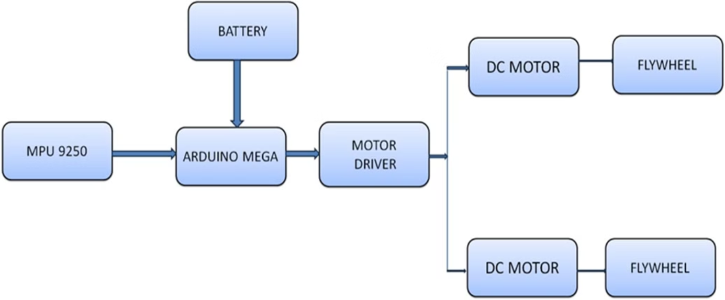
Block Diagram:

Slide 12
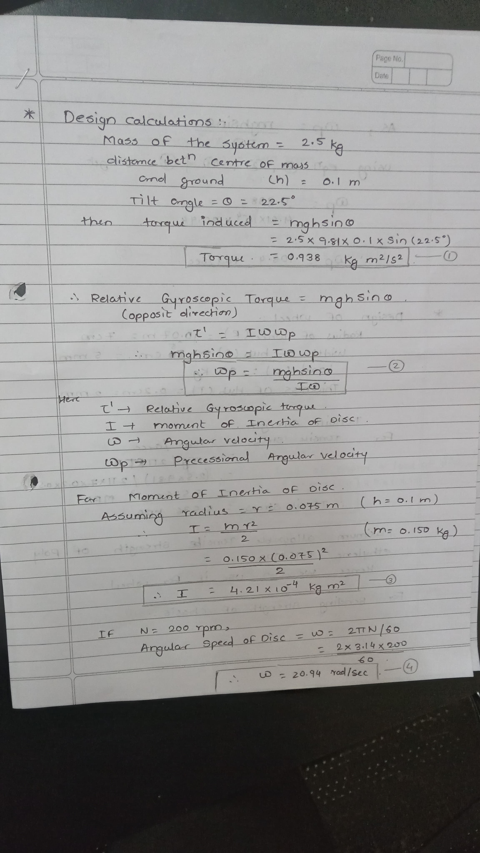
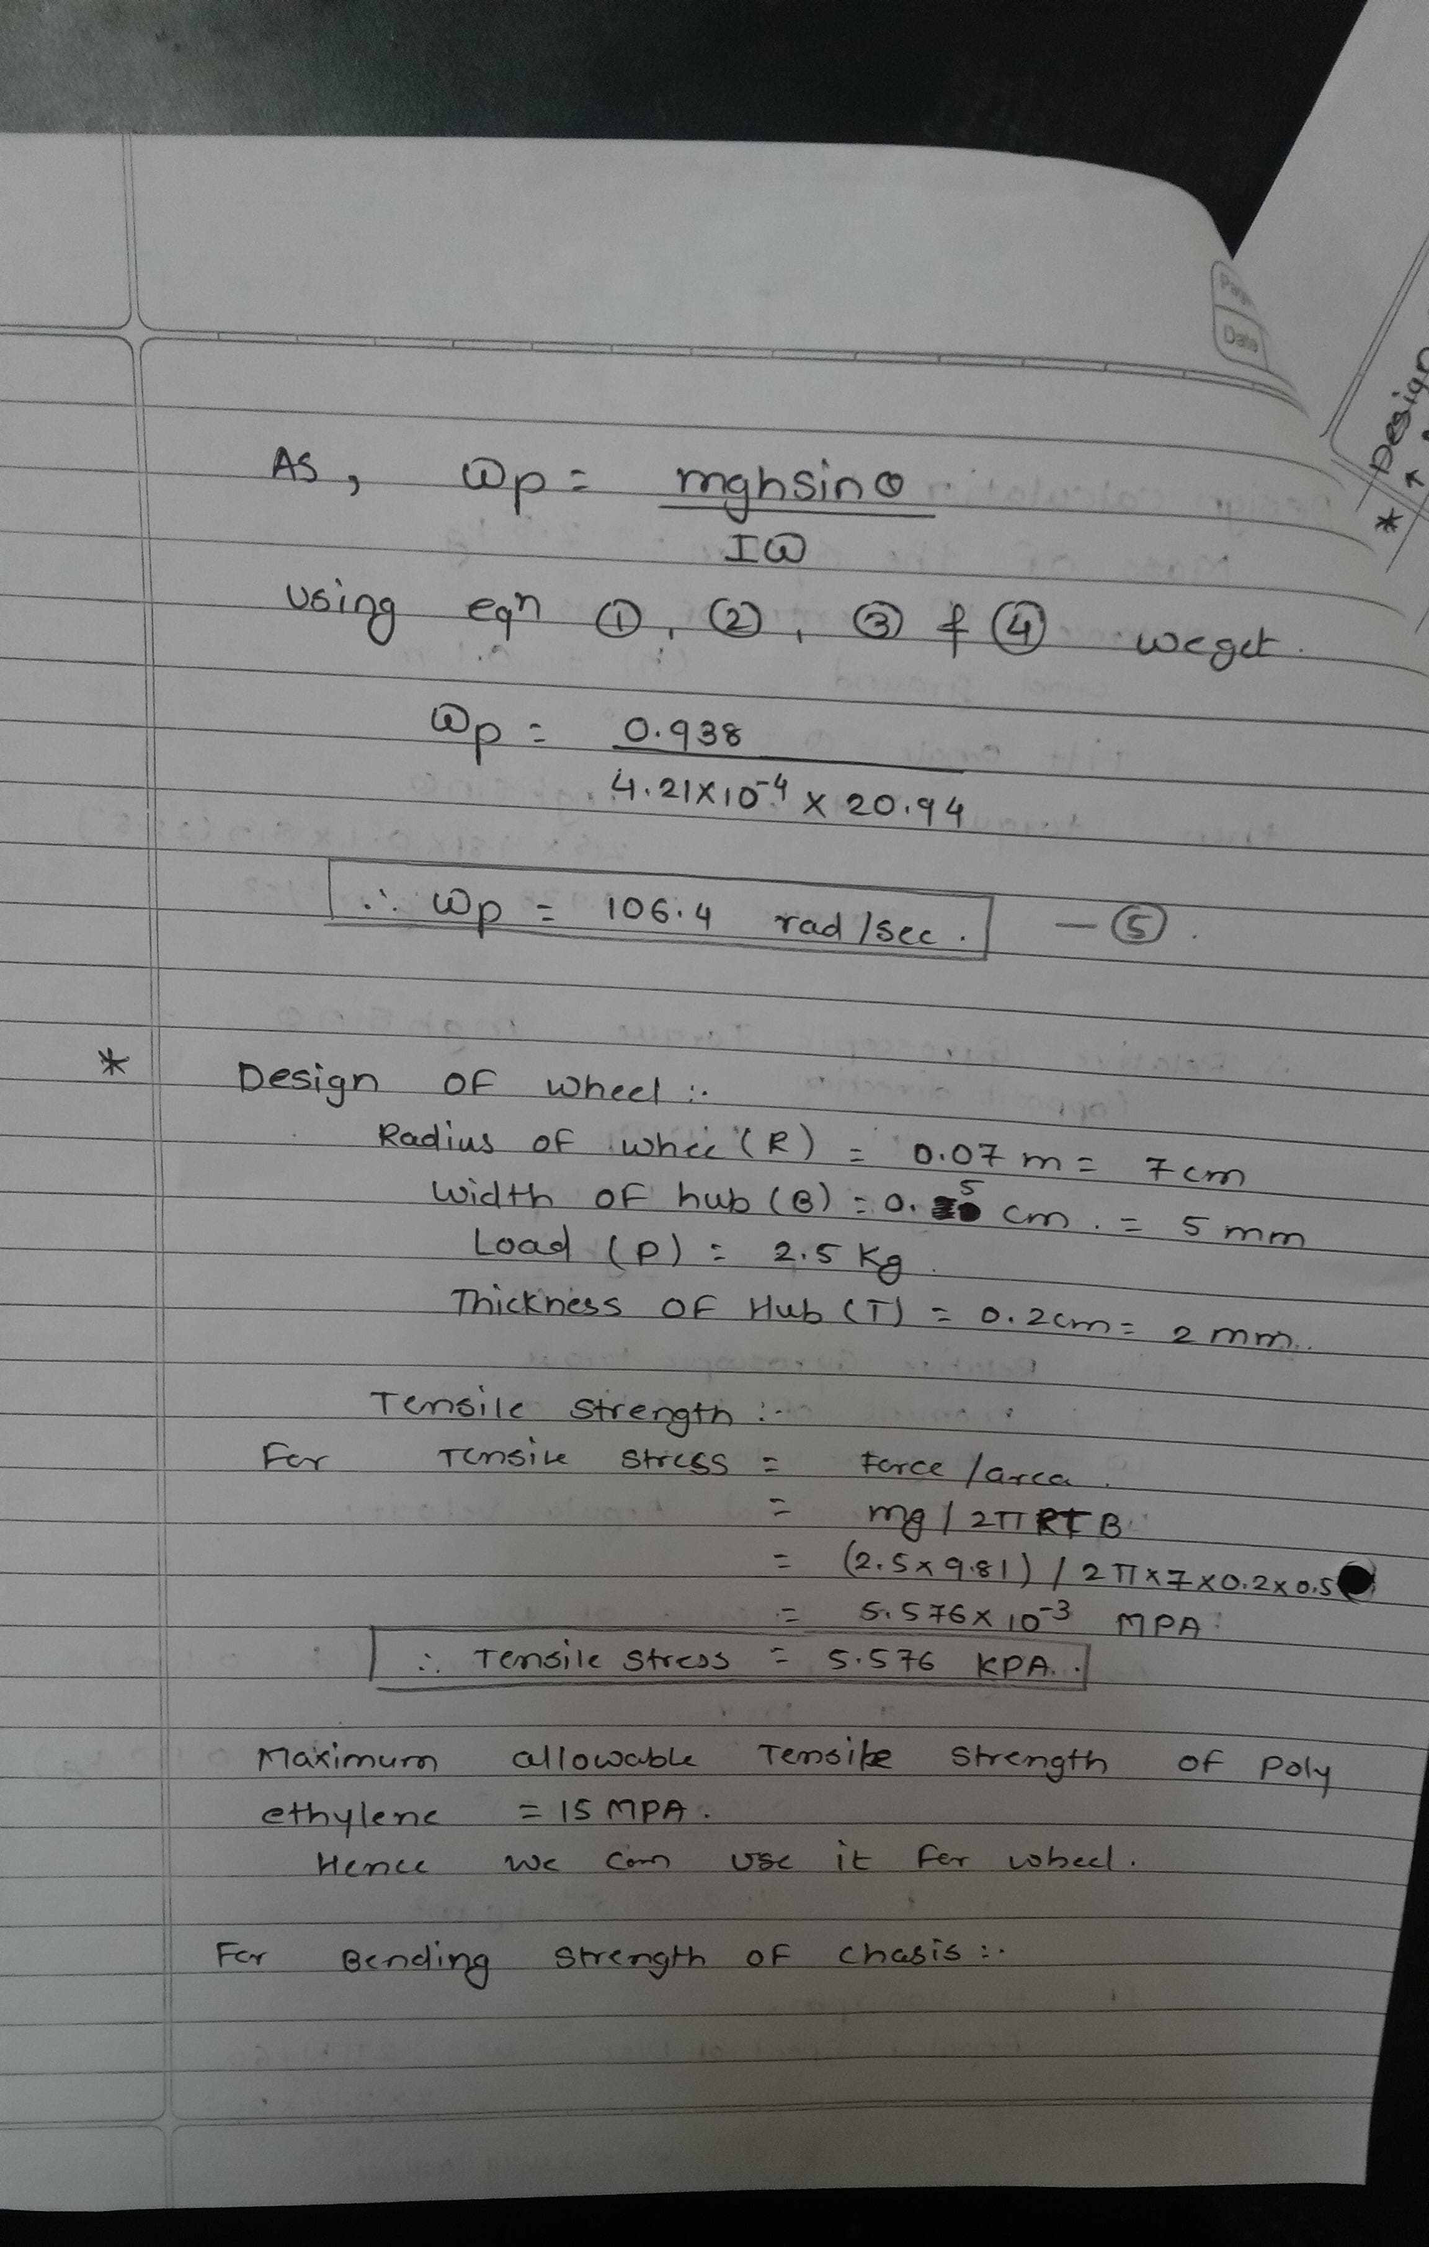
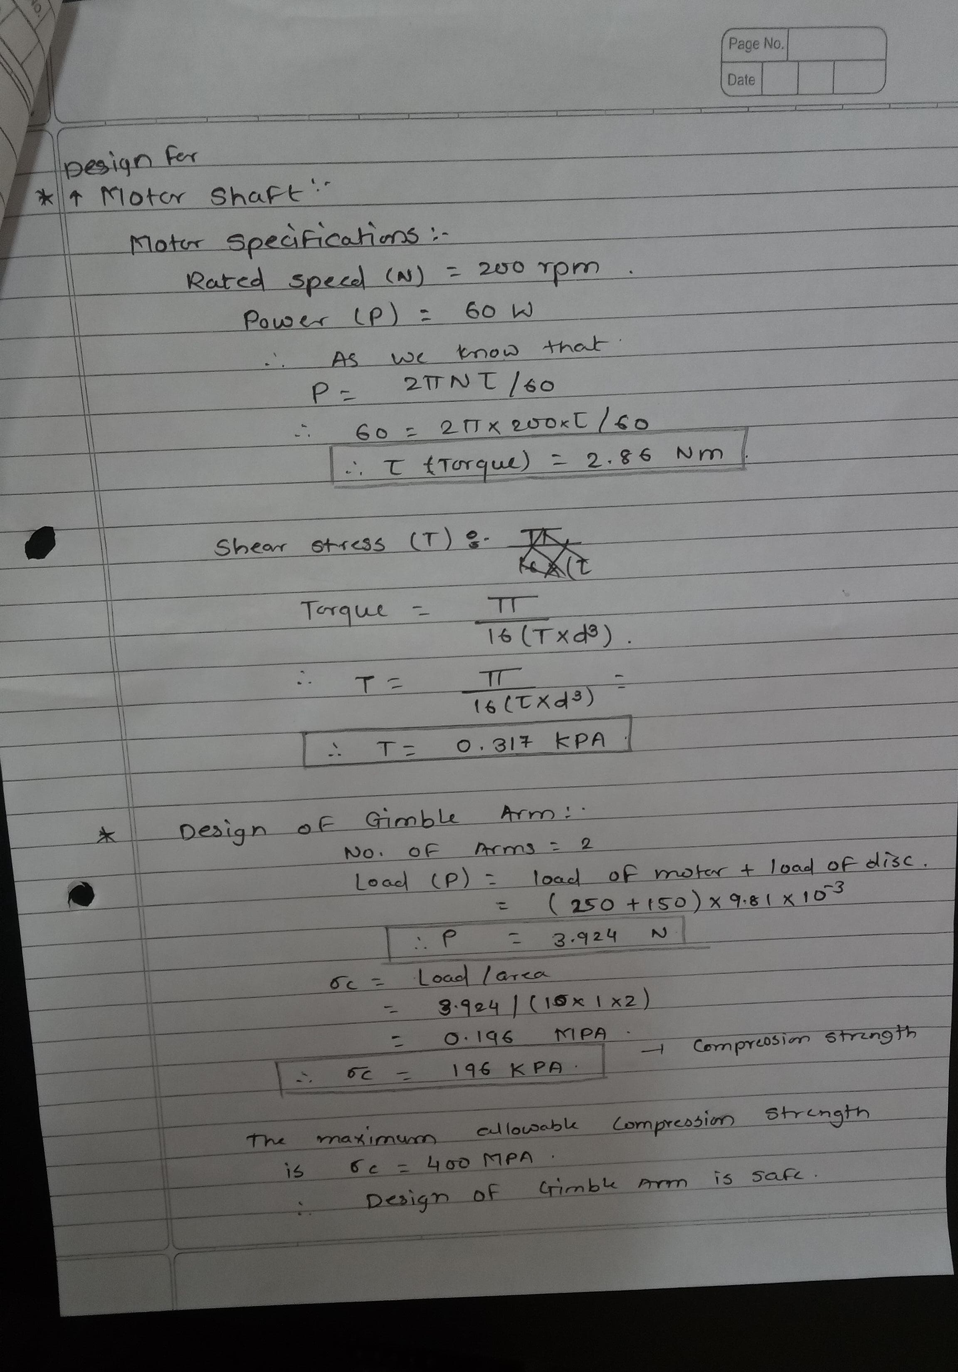
Sample Calculations:

Slide 13
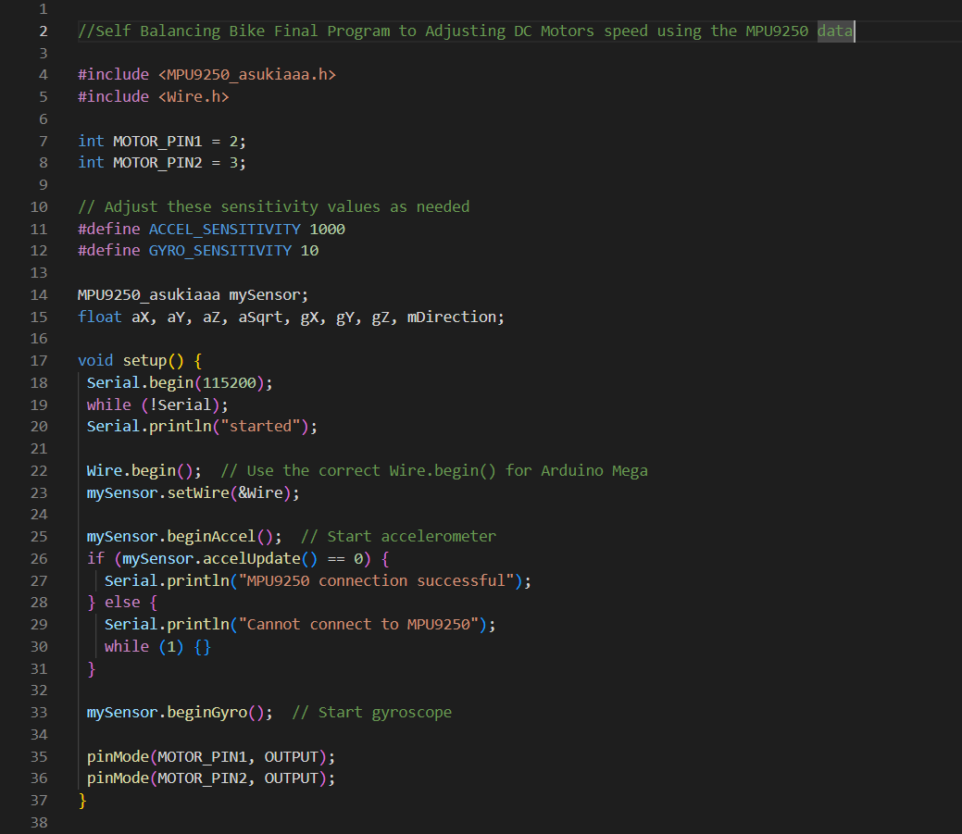
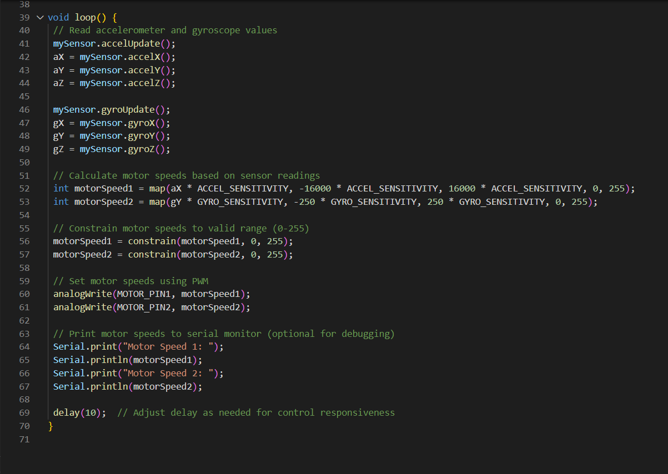
Program:

Slide 14
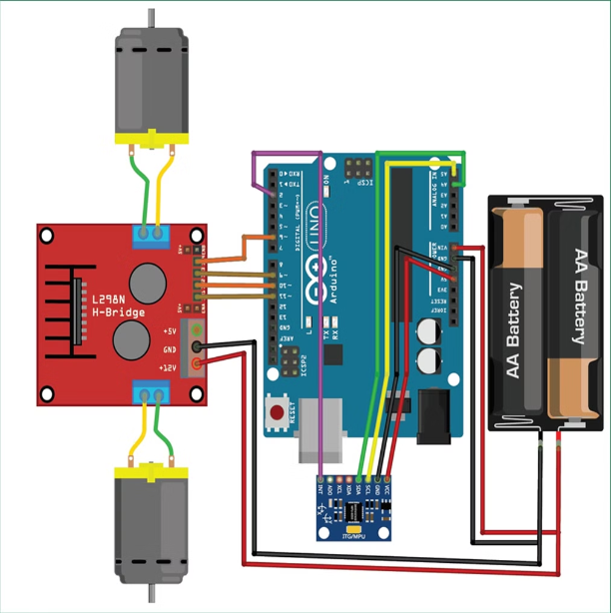
Simulation:

Slide 15
Results:
• Recreational cycling: Offering a more accessible and enjoyable experience for people with balance challenges, beginners, older adults, and those seeking a novel riding experience.
• Urban commuting: Providing a stable and potentially safer alternative to traditional bicycles for short-distance urban trips.
• Last-mile delivery: Enabling more efficient and eco-friendly delivery services in dense urban areas, potentially with cargo-carrying capabilities.

Slide 16
Analysis:
This thesis presents work on the use of CMG and PD controller to balance the bike. The CMG is an effective torque amplification device and has a short response time. A state space model of the bicycle with the CMG and a close loop controller was created in the control design assistant.

Slide 17
Conclusion:
The project concludes that the self-balancing bike prototype is a steeping stone for future advancement that holds immence potential. Self balancing bike offer greater stability and ease of use for riders of all skill levels. They have potential to improve safety and personal transportation. They can empower people by providing a new mode of transportation.

Slide 18
Learning Outcomes:
· Learned & grew: Gained skills in embedded systems programming & troubleshooting on self-balancing vehicle project. Improved communication & teamwork. Overcame complex designing challenges.
· Positive impact: Praised for problem-solving skills & contributions to brainstorming sessions. Improved code documentation based on supervisor feedback.
· Confidence & clarity: Internship boosted confidence & motivation for embedded systems engineering career. Increased self-awareness of troubleshooting & critical thinking strengths.
· Relevance & takeaways: Applied classroom knowledge to project. Learned about design iteration & testing in hardware development. Recommend internship for understanding practical applications in electronics & telecom.

Slide 19
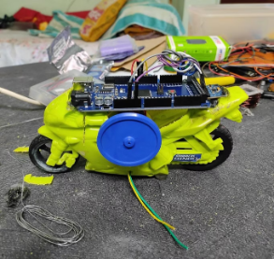
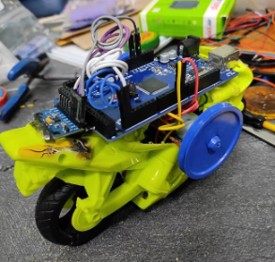
Prototype and Team Photographs:
Prototype Photo 1
Prototype Photo 2

Slide 20
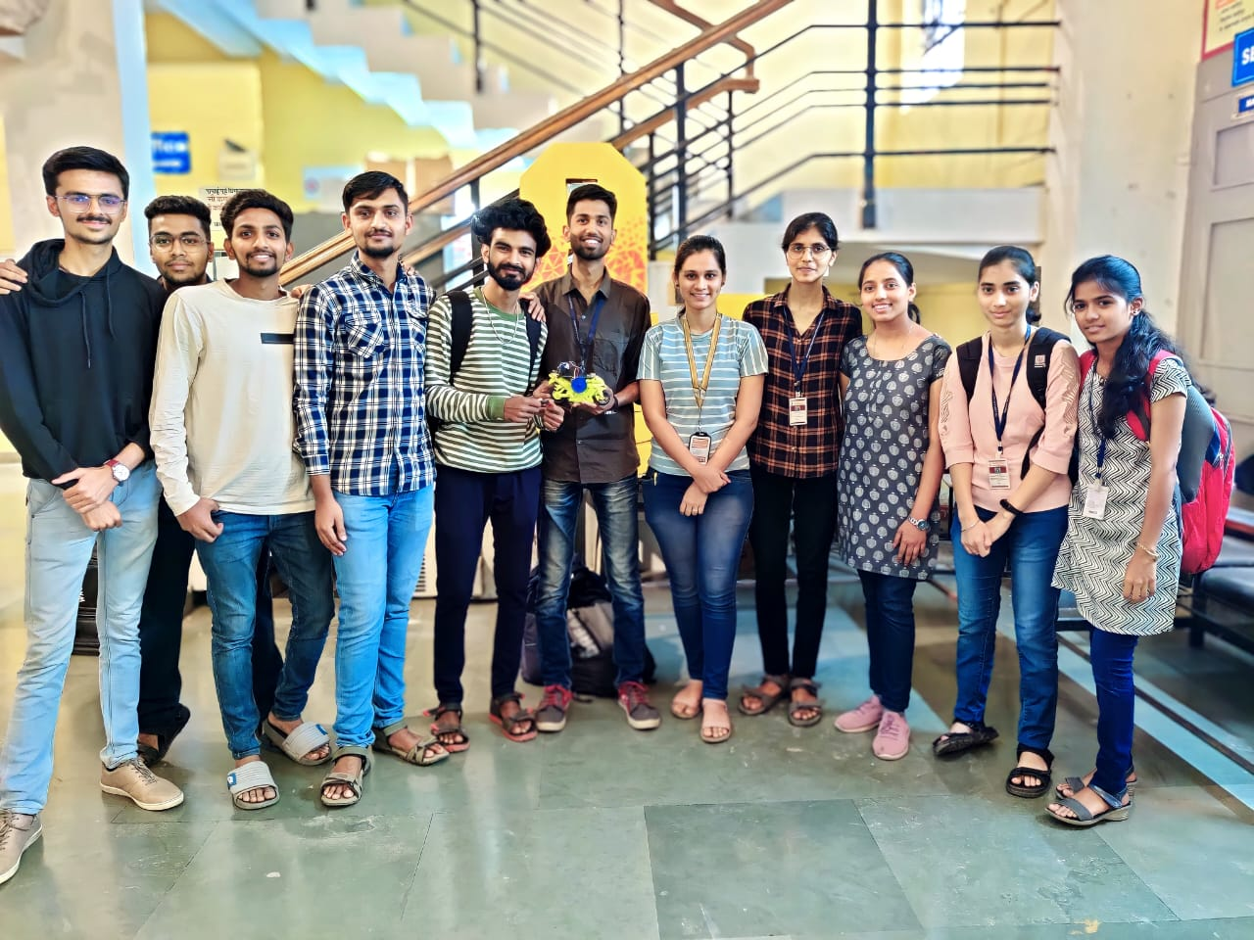
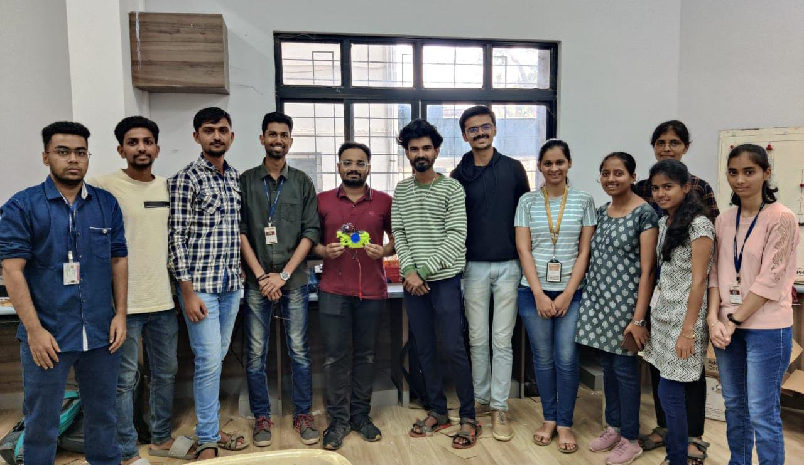
Final Submission Of Project
Project Team

Slide 21
Reference Links:
• https://robu.in/product/l298-based-motor-driver-module-2a/
• https://in.mathworks.com/help/supportpkg/arduino/ref/estimate-orientation-ahrs.html
•https://circuitdigest.com/microcontroller-projects/arduino-based-self-balancing-robot
•https://in.mathworks.com/support/search.html/videos/sensor-fusion-part-2-fusing-a-mag-accel-and-gyro-to-estimate-orientation-1569411056638.html?fq%5B%5D=asset_type_name:video&fq%5B%5D=category:fusion/index&page=1

Slide 22


